Slide 1

team@sentinel:~/capstone $ ./present.sh
TicketSenpai
A concert ticket shop we built on purpose with security holes, then attacked, then fixed.
Team Sentinel: Om Sushant Suwan Bipul
CSC 489 Web Application Security
Capstone, Milestone 4
Notes:
Sushant opens. We are Team Sentinel, project is TicketSenpai, a concert ticketing site. Four stages: build, attack, defend, present. Keep this to 20 seconds.

Slide 2
Credit where it is due
drop bibas.jpg
here
先輩
Senpai means the one who went first and shows you how. Fitting, since the app is literally called TicketSenpai.
▸ Bibas Kandel built most of TicketSenpai.
▸ He could not make it today.
▸ That makes us the kouhai. 後輩.
SENPAI
Team Sentinel
TicketSenpai
Notes:
Quick and genuine, about 15 seconds. Bibas did most of the build, he is out today, we are covering it. To add his photo, replace the dashed box with his picture.

Slide 3
team@sentinel:~/capstone $ ls -1
01-build/ what we built
Sushant
02-attack/ breaking into another team's app
Suwan
03-defend/ fixing our own bugs
Om
04-lessons/ what we learned
Bipul
three live demos along the way
Team Sentinel
Agenda
Notes:
Here is the plan. Four parts, one of us each, live demos in the first three. Name each person. 10 seconds.

Slide 4
team@sentinel:~/capstone $ cd 01-build
What we built
Part 1 · Sushant
01 / 04
Notes:
Sushant stays on. Your section. Next slide is the live app demo.

Slide 5
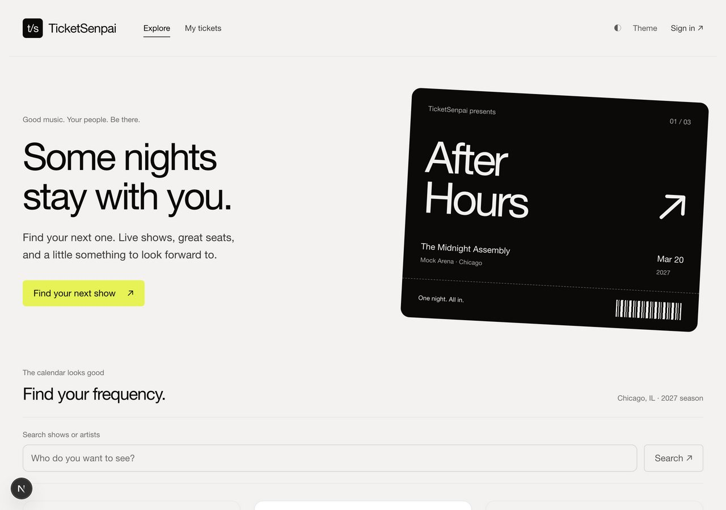
A concert ticket shop
▸ Search shows, pick seats or general admission
▸ Hold seats for eight minutes, then check out
▸ Payment is simulated, no real cards
▸ Reviews, and admins manage the shows
Next.js → Flask API → SQLite
Part 1 · Sushant
TicketSenpai
Notes:
Live demo. Have the app open at 127.0.0.1:3000. Browse a show, search, pick a seat, check out, show the ticket. Under 90 seconds. Say the stack out loud. Screenshot is the backup if it breaks.

Slide 6
We planted six weaknesses on purpose
ID | Weakness | Type | Rated
V01 | SQL injection in search | A03 | CRITICAL
V02 | Stored XSS in reviews | A03 | HIGH
V03 | IDOR on orders | A01 | CRITICAL
V04 | Predictable session token | A07 | CRITICAL
V05 | Plaintext passwords | A02 | HIGH
V06 | Debug traceback leak | A05 | HIGH
Part 1 · Sushant
Built to be broken
Notes:
Six real bug types from the OWASP Top 10, on purpose. Name the three required ones: SQL injection, XSS, broken access control. Do not read all six. Hand to Suwan.

Slide 7
team@sentinel:~/capstone $ cd 02-attack
The attack phase
Part 2 · Suwan
02 / 04
Notes:
Suwan takes over. The fun part. You get to show a real exploit.

Slide 8
Our target: Team Vortex, “Anyone Can Cook”
A recipe sharing app. We built it from their source and tested every page and endpoint in about six hours.
6
3
CRITICAL
working vulnerabilities
rated critical
overall risk
Part 2 · Suwan
Anyone Can Cook
Notes:
We were assigned Team Vortex's recipe app. Built it locally, went endpoint by endpoint. Six real issues, three critical, whole app rated critical risk.

Slide 9
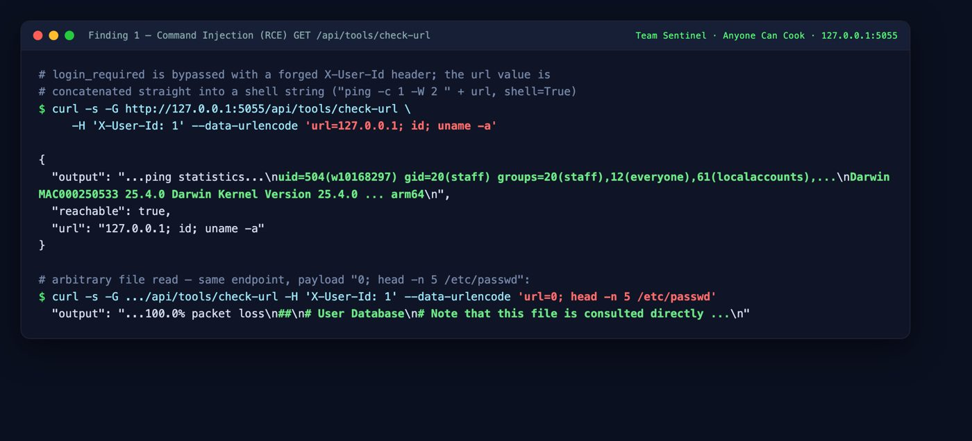
Their link checker ran our commands
CRITICAL
routes/tools.py
# builds a shell string from user input
cmd = "ping -c 1 -W 2 " + target
subprocess.run(cmd, shell=True)
payload: 127.0.0.1; id; uname -a
our commands running on their server
Part 2 · Suwan
Remote command execution
Notes:
Live demo. Terminal with Anyone Can Cook on port 5000. Run the curl from the playbook. The output shows id and uname, our commands ran on their machine. A ping feature gave us full control. Screenshot is the backup.

Slide 10
Three more ways in
▸ SQL injection in the login let us sign in as any account no password needed
▸ A header the server trusted, X-User-Id, let any request become any user set one number, become the admin
▸ The public profile endpoint handed back password hashes and emails readable without logging in
XSS was actually blocked here. Their front end escaped output, so we reported it tested and safe.
Part 2 · Suwan
More findings
Notes:
One line each, quick, no demo needed. Mention the XSS point, it shows you tested fairly. Hand to Om.

Slide 11
team@sentinel:~/capstone $ cd 03-defend
Fixing our own bugs
Part 3 · Om
03 / 04
Notes:
Om takes over. You own the code, most questions come here.

Slide 12
Another team tested TicketSenpai
They found five of our six planted bugs and rated three critical. We fixed every one, plus the password storage they did not flag.
Weakness | Rated | Status
SQL injection in search | CRITICAL | fixed
IDOR on orders | CRITICAL | fixed
Predictable session token | CRITICAL | fixed
Stored XSS in reviews | HIGH | fixed
Debug traceback leak | HIGH | fixed
Plaintext passwords | hardening | fixed
Part 3 · Om
The report on us
Notes:
They found five of six, three critical. We fixed all, and hashed passwords which they never flagged. Then two real fixes as diffs.

Slide 13
V01: SQL injection in search
CRITICAL
git diff · backend/ticketsenpai/__init__.py
- sql = f"... name LIKE '%{query}%' ..."
- g.db.execute(sql)
+ sql = "... name LIKE ? OR artist LIKE ? ..."
+ g.db.execute(sql, (pat, pat, offset))
The search text is bound as data now, so it cannot change the query. The password dump returns an empty list.
Notes:
Before: we pasted the search box straight into SQL, a UNION dumped every password. After: fixed query text, input bound as a parameter. Live option: run the attack on old 5101 and fixed 5001.

Slide 14
V04: forgeable session token
CRITICAL
git diff · backend/ticketsenpai/__init__.py
- token = f"session-{user['id']}"
+ token = secrets.token_urlsafe(32)
+ # rotated on every login
The old token was just session- plus the user id, so session-3 made you the admin. Now it is random. Guessing session-3 returns 401.
Notes:
Old cookie was session dash user id. Admin is id 3, type session-3 and you are admin. Now random 32 byte token, rotated each login.

Slide 15
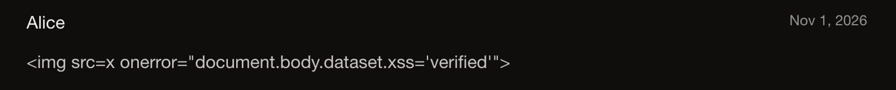
V02: stored XSS in reviews
HIGH
A review holding an image tag with an onerror ran script for everyone who opened the event. Now React renders it as plain text.
the payload now shows as text instead of running
- <div dangerouslySetInnerHTML={{__html: body}} />
+ <div className="review-body">{body}</div>
Part 3 · Om
Output encoding
Notes:
We used to drop review HTML straight into the page. A crafted image tag ran code in other people's browsers. Fix was one line, render as text. Screenshot shows the payload sitting there as text.

Slide 16
We turned every exploit into a test
python -m unittest
test_v01_search_injection_is_treated_as_text ... ok
test_v03_order_detail_is_owner_scoped ........ ok
test_v04_session_tokens_are_random_and_rotate . ok
test_v06_errors_do_not_disclose_internals .... ok
----------------------------------------
Ran 20 tests ... OK
Each old exploit is now a test. It fails on the old code and passes on the fixed code, so the fixes cannot quietly come back.
Part 3 · Om
Proof it stays fixed
Notes:
Strongest proof and most reliable demo. Run the suite live, all 20 pass. On the old code five go red. Hand to Bipul.

Slide 17
team@sentinel:~/capstone $ cd 04-lessons
What we learned
Part 4 · Bipul
04 / 04
Notes:
Bipul closes. No demo. Talk through the lessons in your own words.

Slide 18
Three things that stuck
▸ Attacking first made us better defenders once you break into one app, you spot the same mistakes in your own
▸ Most fixes were small a bound parameter, a random token, rendering text instead of HTML
▸ One setting can undo a fix debug was off in the app but still on in the dev server until we checked both
Part 4 · Bipul
Lessons
Notes:
Say these in your own words. Pick the one that felt most true and add a sentence. Hardest part: understanding someone else's code to break it. Surprise: how small the fixes were.

Slide 19
team@sentinel:~/capstone $ logout
Questions?
Thanks for watching. Built by Bibas, presented by Sushant, Suwan, Om, and Bipul.
Team Sentinel
TicketSenpai
Notes:
That is our four weeks, happy to take questions. Code questions to Om, attack questions to Suwan. See the packet for likely questions.

